Slide 1
Tutorial 9: Binary Search Trees
Junyi Ao
November 7, 2022

Slide 2
Table of Contents
Binary Search Trees
Insertion and Deletion
AVL tree

Slide 3
Properties
BST is a binary tree, as suggested by its name. The keys in a binary search tree are always stored in such a way as to satisfy the binary-search-tree property
We can represent BST by a linked data structure in which each node is an object
In addition to a key and satellite data, each node contains attributes left, right, and p that point to the nodes corresponding to its left child, its right child, and its parent, respectively
Property (BST property)
Let x be a node in a binary search tree. If y is a node in the left subtree of x, then y.key <= x.key. If y is a node in the right subtree of x, then y.key >= x.key.

Slide 4
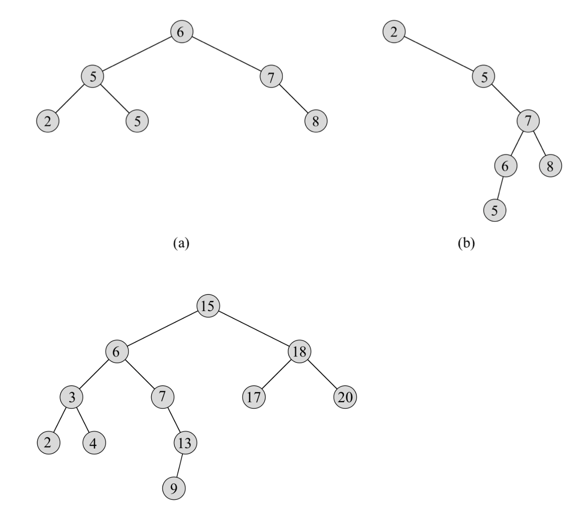

Slide 5
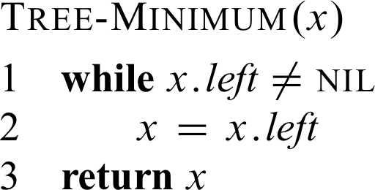
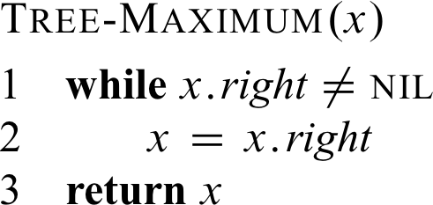
Finding Maximum or Minimum
Just go to the rightmost (or leftmost) node.

Slide 6
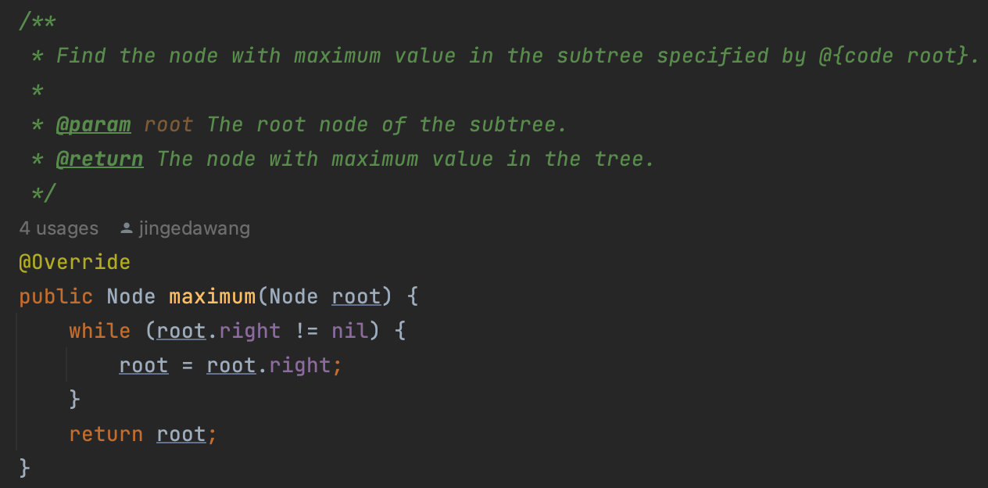
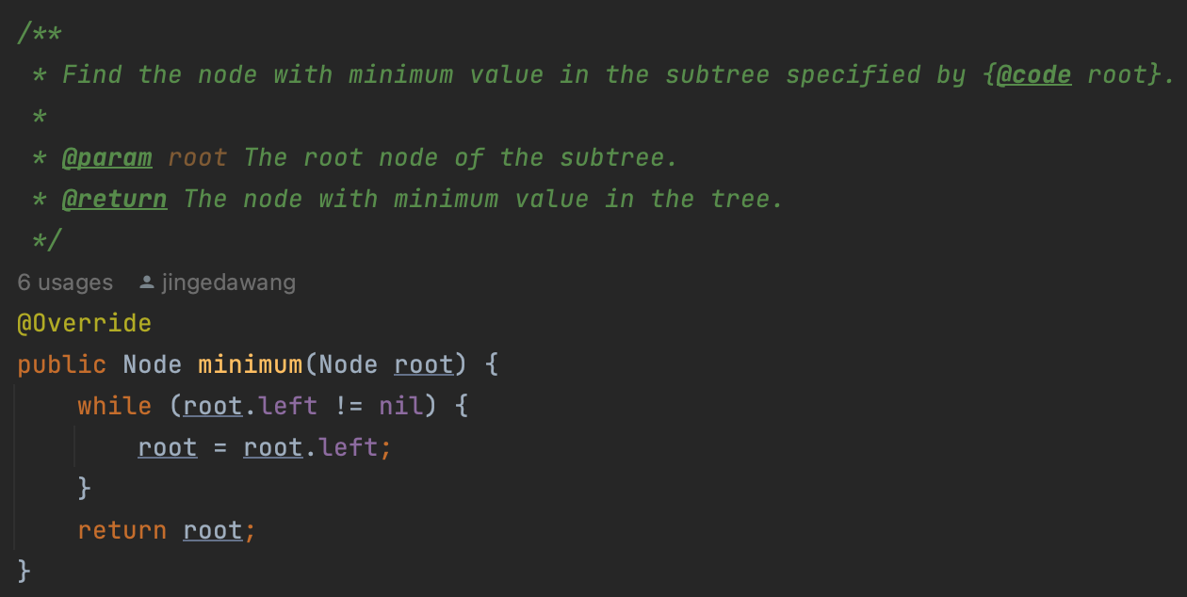
Finding Maximum or Minimum: Java Program

Slide 7
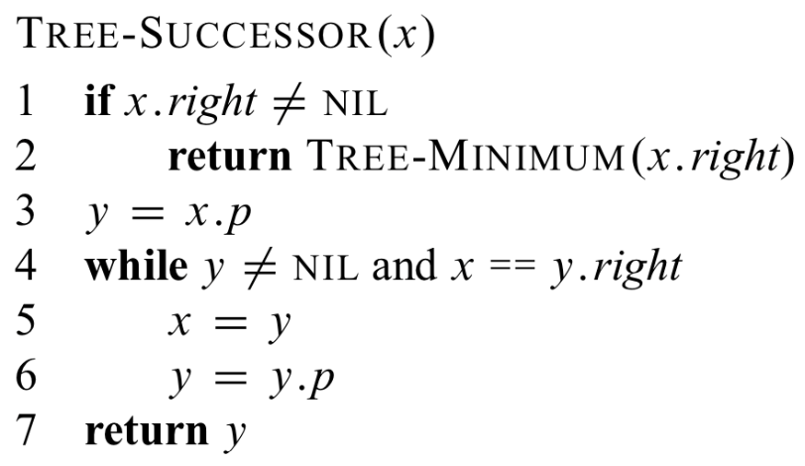
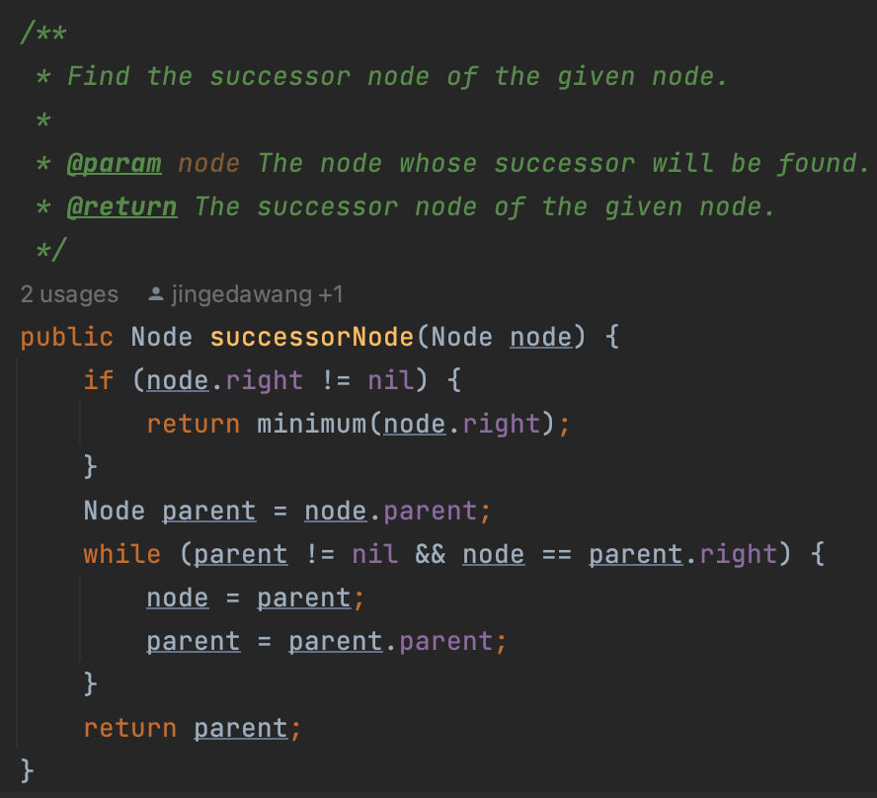
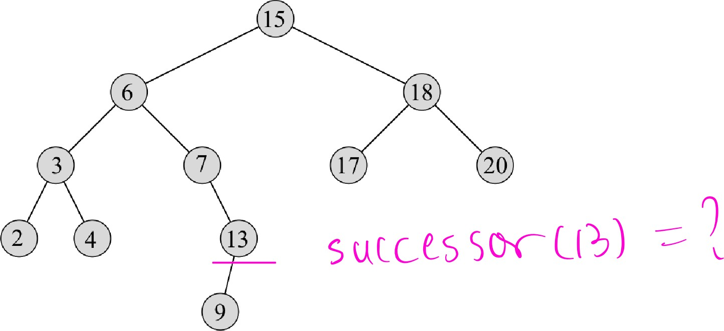
Finding Successor or Predecessor

Slide 8
Time Complexity
Exercise 1
Inplement finding predecessor.
Theorem 1
The running time of finding successor (or predecessor) on a tree of height h is O(h)
One-sentence proof: We either follow a simple path up the tree or follow a simple path down the tree.

Slide 9
Insertion
In general, find a suitable place and insert the new node. The function begins at the root of the tree and the pointer x traces a simple path downward looking for a NIL to replace with the input item z. The procedure maintains the trailing pointer y as the parent of x.
We need the trailing pointer y, because by the time we find the NIL where z belongs, the search has proceeded one step beyond the node that needs to be changed.
Theorem 3
The procedure of insertion runs in O(h) time on a binary search tree of height h.

Slide 10
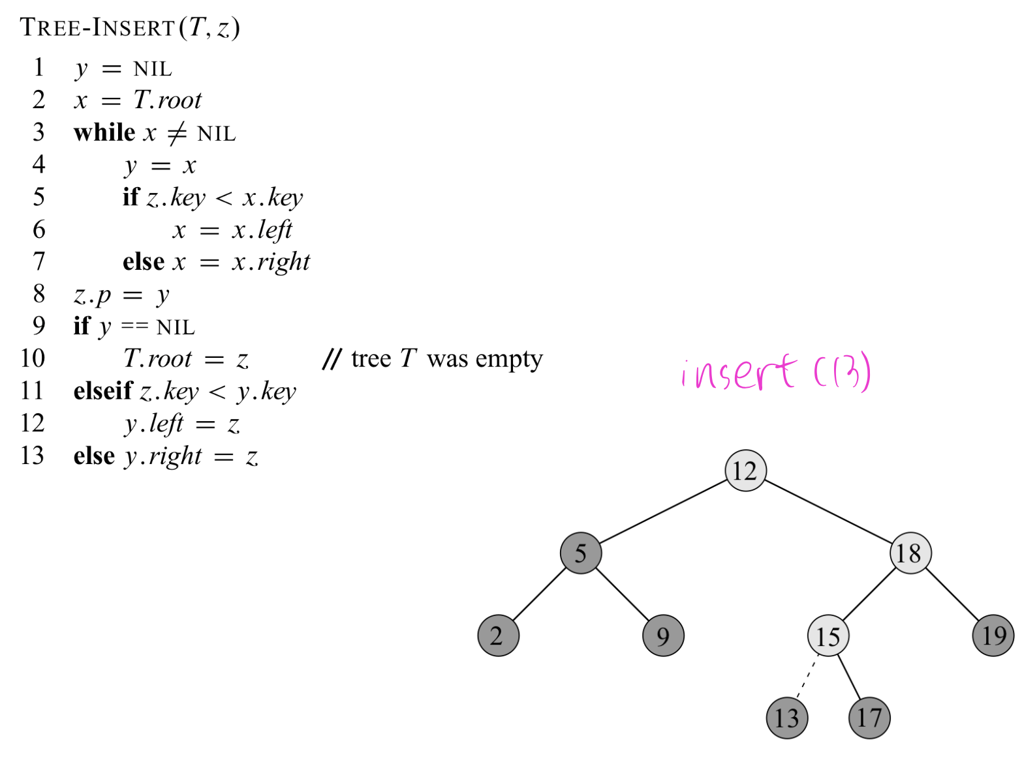
Insertion

Slide 11
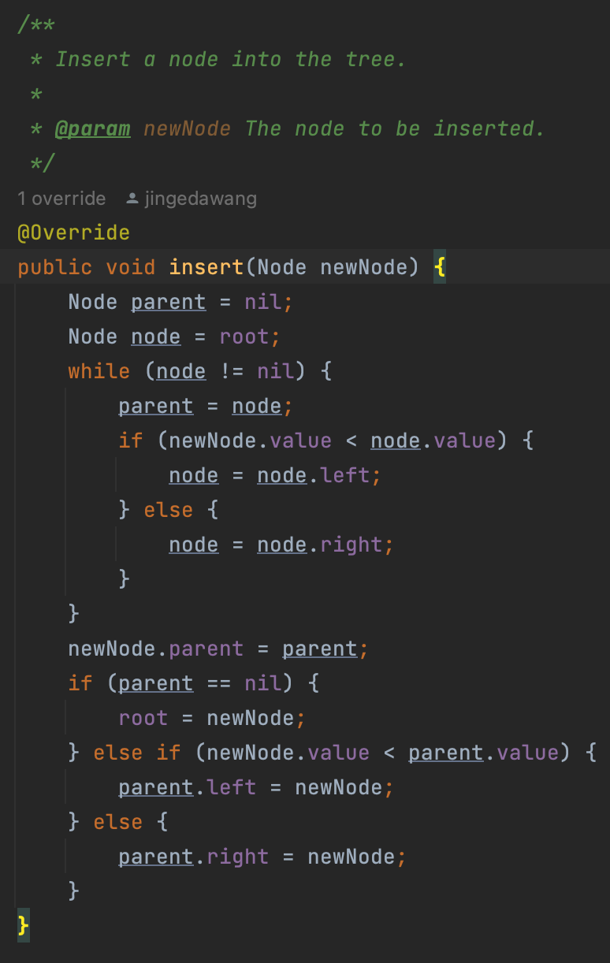
Insertion: Java Program

Slide 12
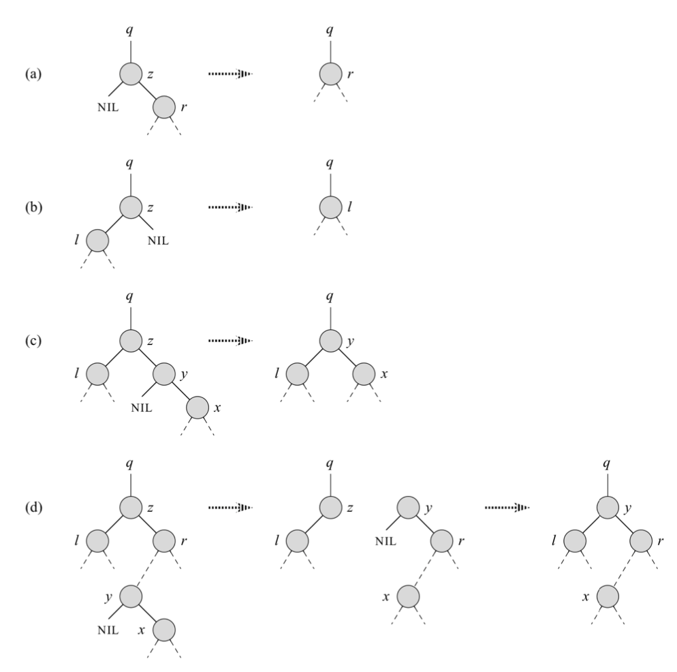
Deletion
The overall strategy for deleting a node z from a binary search tree T has three basic cases.
  z has no children
  z has just one child
  z has two children

Slide 13
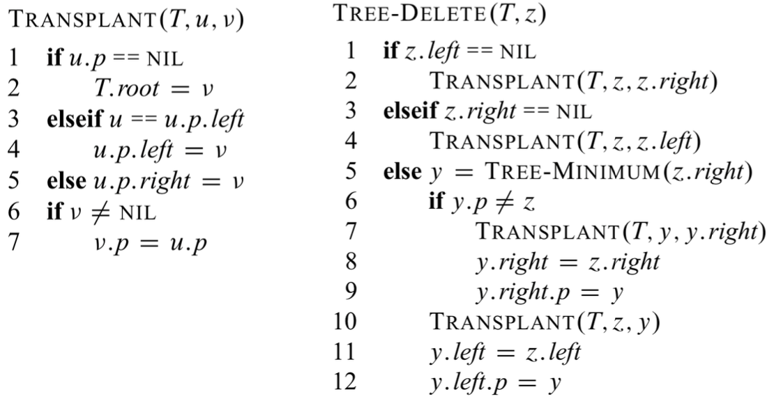
Deletion: Transplant Operation
In order to move subtrees around within the binary search tree, we define a subroutine TRANSPLANT, which replaces one subtree as a child of its parent with another subtree.

Slide 14
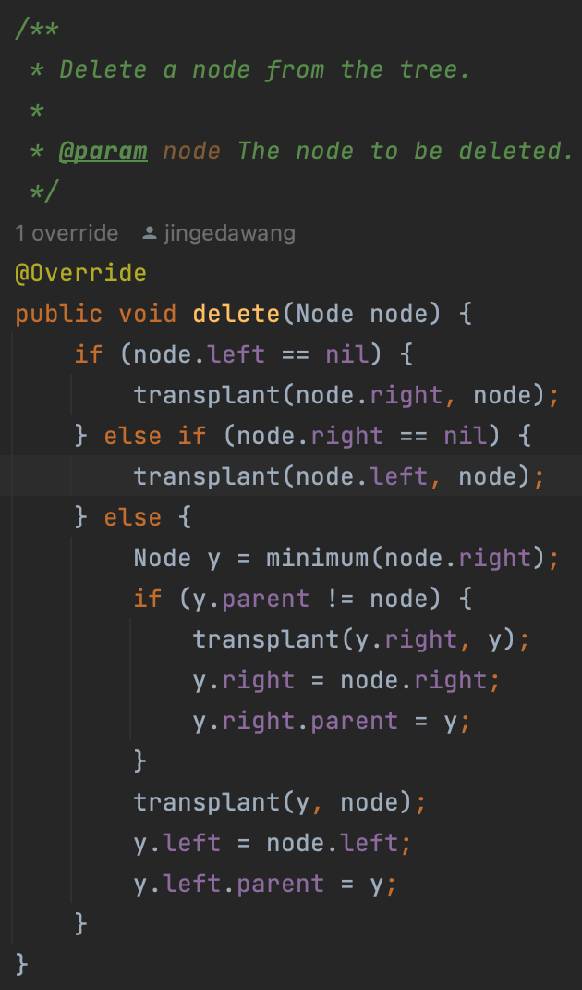
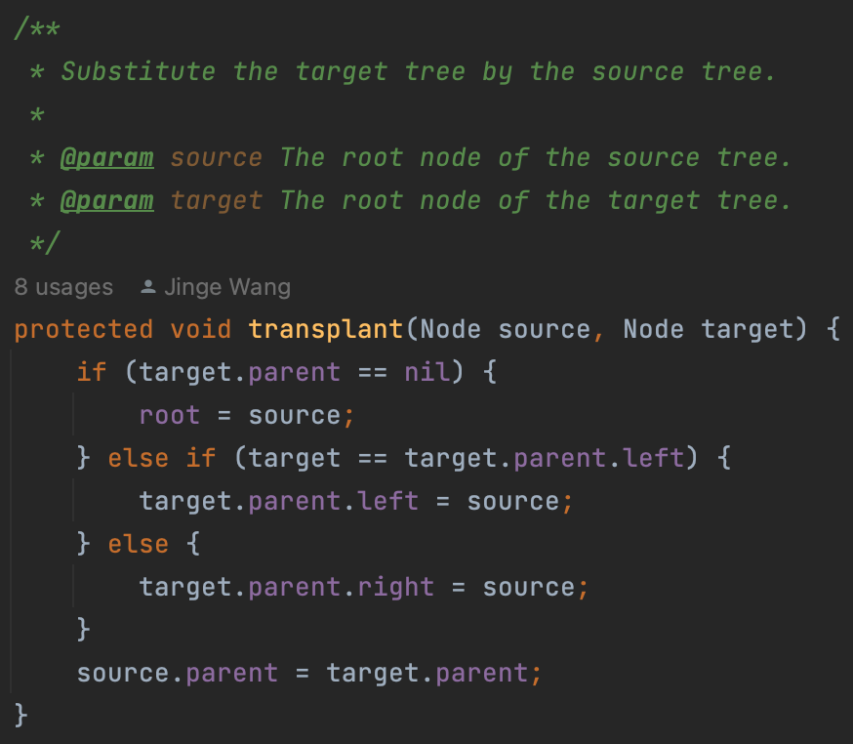
Deletion: Transplant Operation (Java Program)

Slide 15
Balanced Binary Trees
Definition (height balanced binary tree)
A binary tree T is (height) balanced if the following holds on every internal node u of T :
For each node x, the heights of the left and right subtrees of x differ by at most 1.
If u violates the above requirement, we say that u is (height) imbalanced.
Motivation: We can examine our operations first, and we can find that their time complexity is related to the height of the tree h (O(h) for many). To make the operations more effective, we need to ”compress” the height of the tree, which means we need to make our tree more ”balanced”.

Slide 16
Remarks
Remark 1
Here comes a problem: how can we guarantee that the AVL tree is height balanced at every point during different operations?
Let us assume that an AVL tree is height balanced at some point of operation. If the next operations is to "search" for some nodes, e.g. a node with certain key, maximum, minimum, predecessor, or successor, then the structure of the tree is not changed, and the tree will remain balanced.
However, if we do insertion or deletion of a node, the structure of the tree will change, and it may not maintain the original properties.

Slide 17
Remarks
Remark 2
Let us first consider what property will be violated using original insertion and deletion.
BST property will hold, as it holds for all binary search trees, which is maintained in our original operations.
Height-balance property may not hold, if we insert or delete a node to make it more "imbalanced". Roughly speaking, we may make the (absolute) difference more than 1 by inserting a node into a "taller" subtree or deleting a node in a ”shorter” subtree.
Remark 3
In fact, we can find a way to modify our insertion and deletion functions, to make the tree height-balanced, with the time complexity O(h) = O(log n) . For that purpose, we have an elegant way to adjust the structure of the tree, ”rotation”.

Slide 18
Rotation
Remark 1
Rotation is a local operation in a search tree that preserves the binary-search-tree property. There are two kinds of rotations: left rotations and right rotations.
Remark 2
When we do a left rotation on a node x, we assume that its right child y is not T.nil. x may be any node in the tree whose right child is not T.nil.

Slide 19
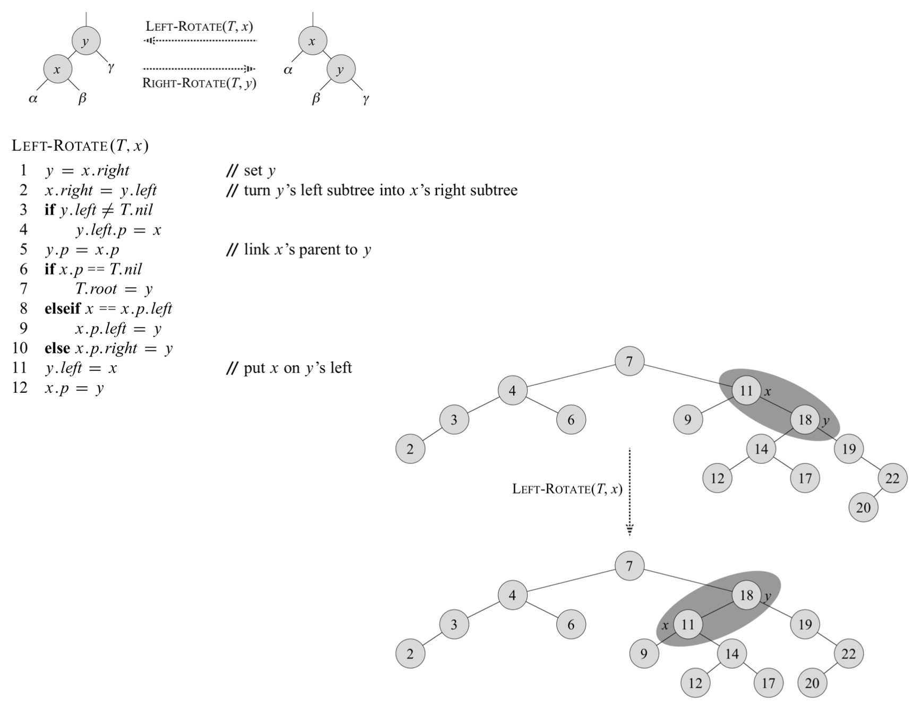

Slide 20
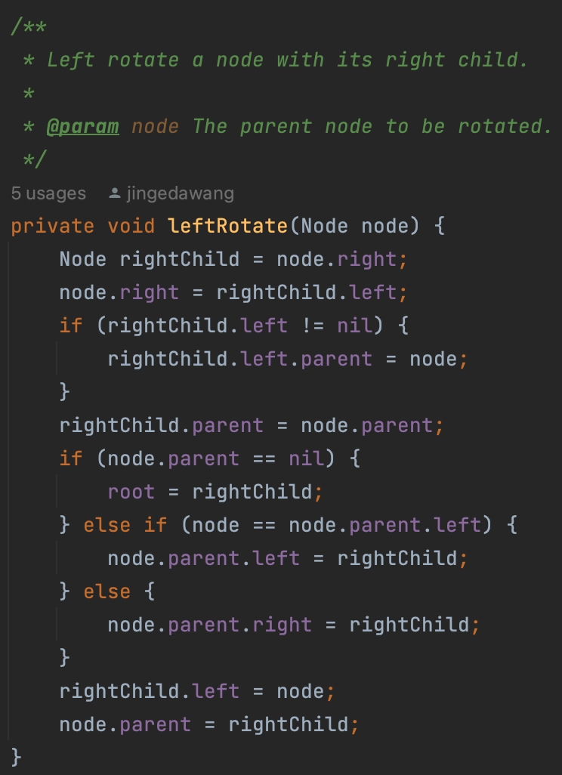
Rotation: Java Program

Slide 21
Exercises
Exercise 3
Implement RIGHT-ROTATE.

Slide 22
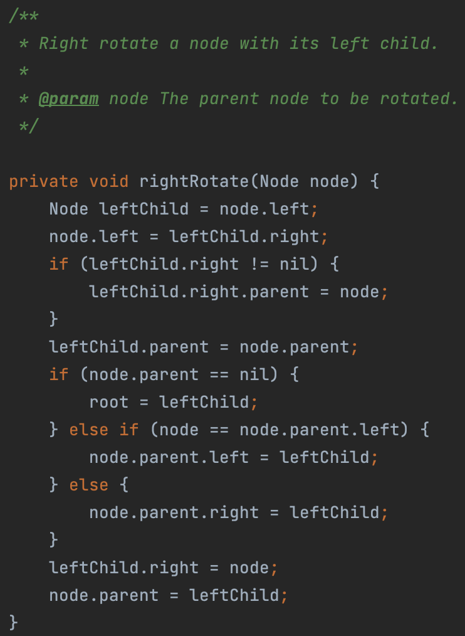
Exercises

